Slide 1
Fake News Propagation and Detection: A Sequential Model
瞿心仪
2022214329
Yiangos Papanastasiou (2020)

Slide 2
CATALOG
1
2
Introduction
Related Literature
3
4
The Agents’ News-Sharing Process
A Model of Fake News
5
The Platform’s Inspection Problem
6
The Impact of Fake News on Agent Opinions
7
Discussion

Slide 3
Part 01
Introduction

Slide 4
Background
In the run-up to the 2016 U.S. presidential election, articles containing fabricated information (now widely referred to as “fake news”) were actively shared between U.S. voters on social-media platforms.
One postelection analysis found that in the final 3 months of the presidential campaign, the 20 top-performing fake news stories received more Facebook engagements than the 20 top-performing truthful newsstories.
Social-media platforms have recently adopted various measures:
preventive
corrective

Slide 5

Our Work
A model of news propagation
The platform’s optimal inspection policy
The implications of the platform’s optimal inspection policy for the agents’
learning environment

Slide 6
Part 02
Related Literature

Slide 7
Related Literatures
Sequential decision paradigm Banerjee (1992) and
Bikhchandani et al. (1992)
The implications of social learning for operational decisions Yu et al. (2015), Papanastasiou and
Savva (2016), Crapis et al. (2017)
The operations of
online service platforms Chakraborty and Swinney
(2017), Marinesi et al. (2018)
The fake-news phenomenon
Vosoughi et al. (2018),
Allcott and Gentzkow (2017)

Slide 8
Part 03
A Model of Fake News

Slide 9
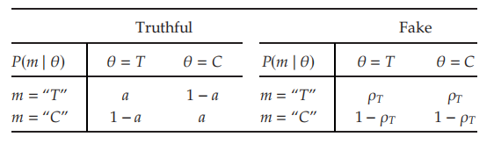
A Model of Fake News
θ ∈ {T, C}
Binary state of the world
(m, a)
The contents of an article
The Signal-Generating Process of a Truthful Article
(Left) and a Fake Article (Right)

Slide 10


A Model of Fake News: Example
Suppose that because of an upcoming Senate vote, the public is interested in whether the burning of fossil fuels is linked to climate change.
Suppose further that an article is circulating on social media, whose contents can be summarized as follows:“UC Berkeley study finds no connection between climate change and the burning of fossil fuels.”
The unobservable state of the world can be described as θ ∈ {Y, N}
The article may be described as (m, a)=(“N”, 0.95)
If it is commonly known that all articles circulating on social media are truthful: prior belief is b=P(θ=N) will be updated to b’.
Instead, the fake article has no impact whatsoever on her belief about θ.

Slide 11
Part 04
The Agents’ News-Sharing Process

Slide 12
Process Description
2 decisions：
whether to “inspect”（cost K)
whether to share (utility u)
Each agent is endowed with a prior opinion over the unobservable state of the world θ ∈ {T, C}
Repeat the 2 decisions
A news article is generated that claims to be informative with respect to the true underlying state.
not share: article dies
share: reveived by another agent
The article is exogenously shared with a randomly chosen agent.

Slide 13
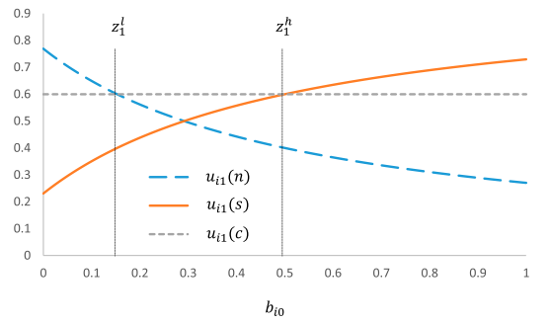
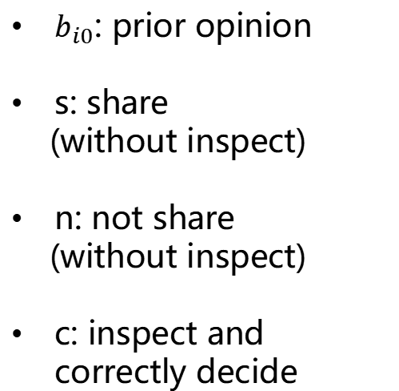
The decision process of an individual agent that receives the article
$b_{i0}$: prior opinion
s: share
(without inspect)
n: not share
(without inspect)
c: inspect and correctly decide
The Period-1 Agent’s Expected Utility from Choosing Action $α_{i1}$ ∈ {s, n, c}

Slide 14
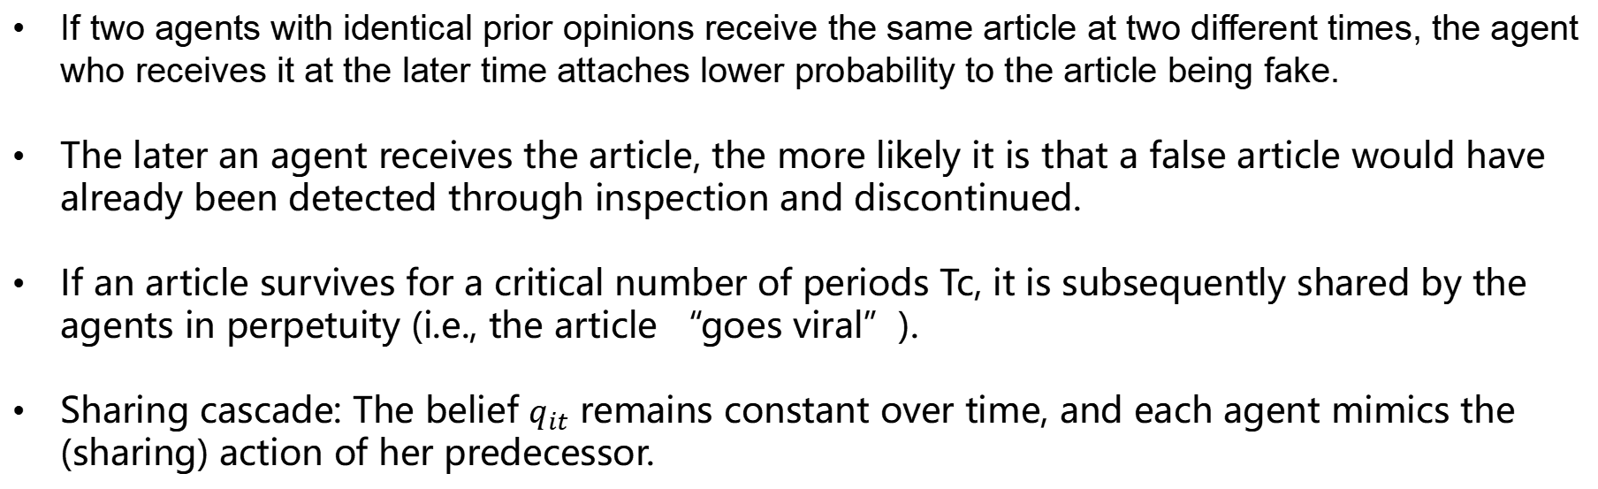
The intertemporal dynamics of the agents’ news-sharing process
If two agents with identical prior opinions receive the same article at two different times, the agent who receives it at the later time attaches lower probability to the article being fake.
The later an agent receives the article, the more likely it is that a false article would have already been detected through inspection and discontinued.
If an article survives for a critical number of periods Tc, it is subsequently shared by the agents in perpetuity (i.e., the article “goes viral”).
Sharing cascade: The belief $q_{it}$ remains constant over time, and each agent mimics the (sharing) action of her predecessor.

Slide 15
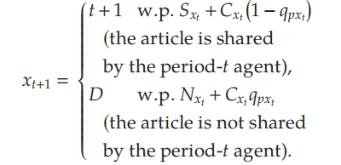
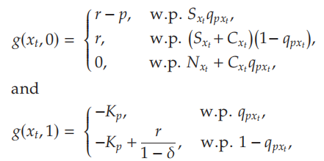

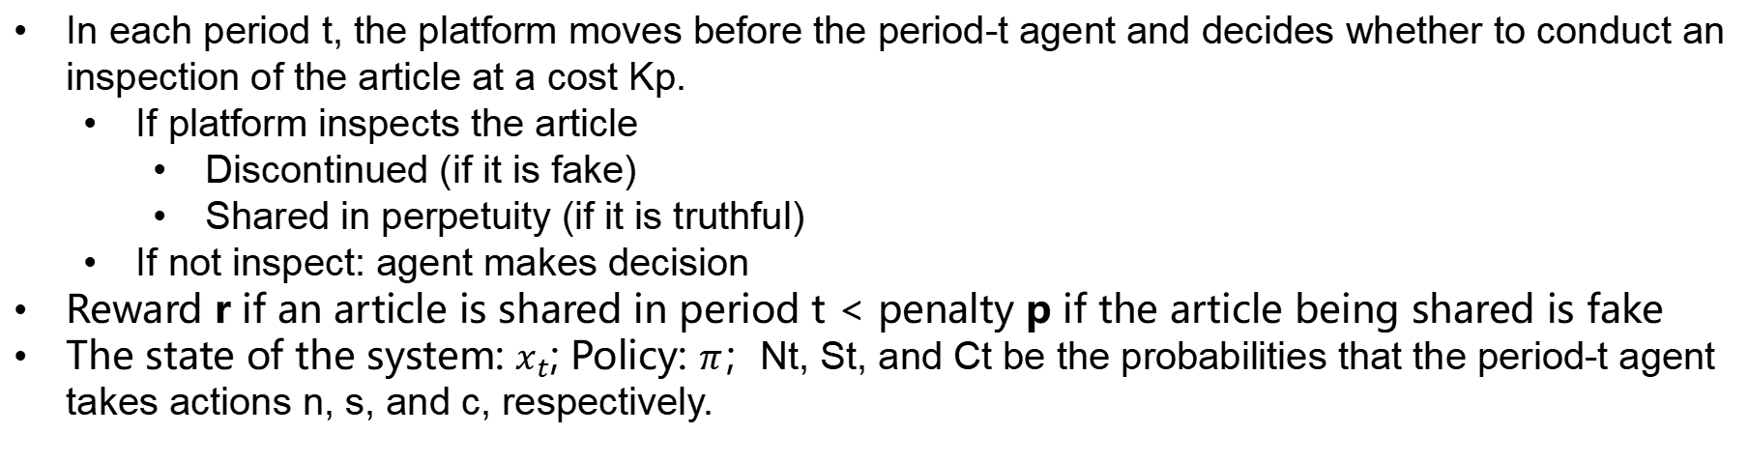
Problem Description
In each period t, the platform moves before the period-t agent and decides whether to conduct an inspection of the article at a cost Kp.
If platform inspects the article
Discontinued (if it is fake)
Shared in perpetuity (if it is truthful)
If not inspect: agent makes decision
Reward r if an article is shared in period t < penalty p if the article being shared is fake
The state of the system: $x_{t}$; Policy: $π$；Nt, St, and Ct be the probabilities that the period-t agent takes actions n, s, and c, respectively.
The platform’s goal is to choose a policy π that max_x0002_imizes the total expected discounted reward.

Slide 16
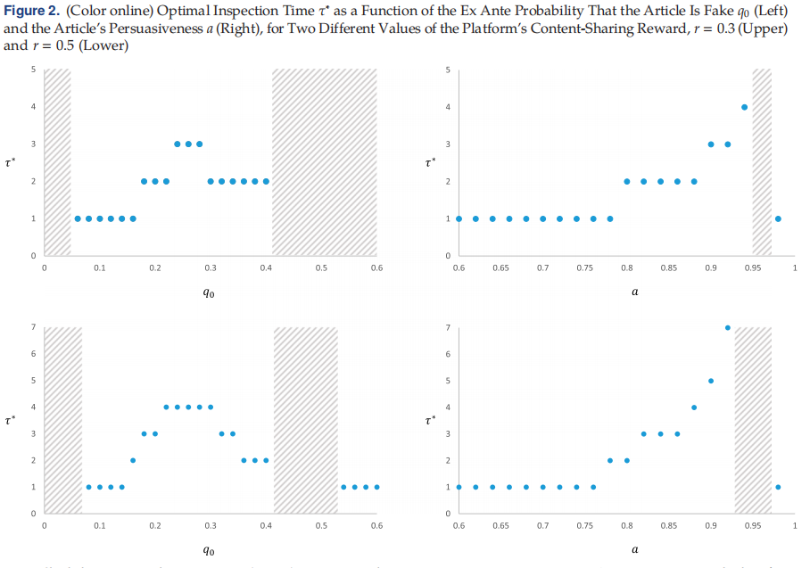
Analysis
Case 1: No agent is willing to incur the cost of conducting an inspection before sharing the article.
Case2: No agent is willing to share the article without first inspecting it.

Slide 17
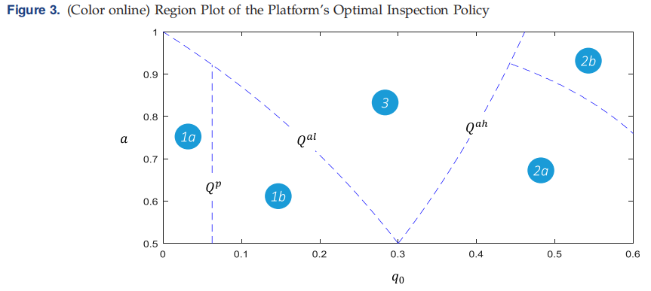
Analysis
Case 1: No agent is willing to incur the cost of conducting an inspection before sharing the article.
Case2: No agent is willing to share the article without first inspecting it.

Slide 18
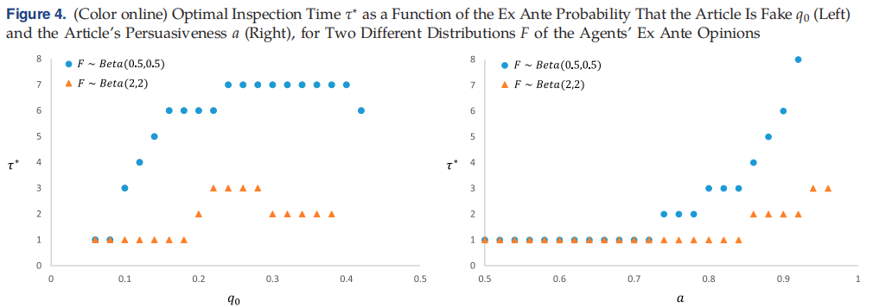
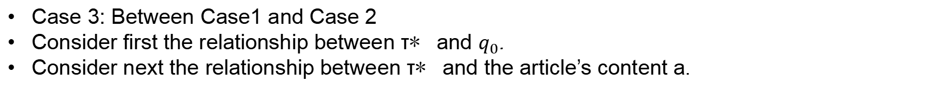
Analysis
Case 3: Between Case1 and Case 2
Consider first the relationship between τ∗ and $q_{0}$.
Consider next the relationship between τ∗ and the article’s content a.

Slide 19
Part 06
The Impact of Fake News on
Agent Opinions

Slide 20
The Impact of Fake News on Agent Opinions
Direct Effect
If the agents fail to recognize an article as fake and the article goes viral, its content causes an erroneous shift in the agents’ opinions.
Indirect Effect
The presence of fake news in the news environment elevates the agents’ suspicions about the validity of truthful articles.
no platform inspection
Direct Effect
The direct effect of fake news is largely mitigated if the platform prescribes an inspection.
having platform inspection
Indirect Effect
The indirect effect of fake news is mitigated completely by the platform’s
policy only if the platform conducts an inspection from the onset of the sharing process.

Slide 21
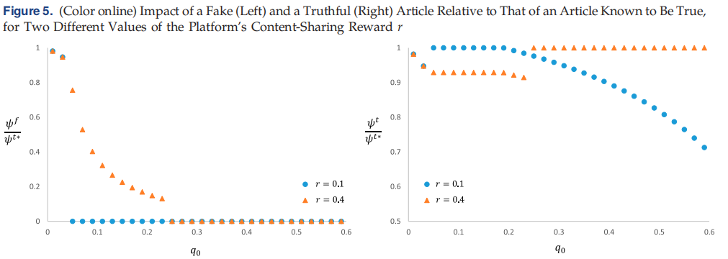
How the platform’s effectiveness in safeguarding the agents’ learning environment depends on the platform’s incentives(r & p in our model).
In environments where the proportion of fake news in circulation is low, lower rewards and/or higher penalties are better.
In environments where the proportion of fake news is high, penalties are ineffective, and the platform’s inspection effectiveness increases when its rewards from content sharing are higher.

Slide 22
Part 07
Discussion

Slide 23
Results and Discussion
In the absence of any platform intervention, fake news articles are likely to proliferate through sequential sharing.
With respect to the optimal platform inspection policy, this is nonmonotone in the ex ante probability that an article is fake.
The incentives that lead to the platform’s policy being more effective depend to a great extent on the characteristics of the news environment.
One significant aspect of the fake-news phenomenon that is not explored in our model is the process by which fake news is generated.

Slide 24
Thanks!

